Slide 1
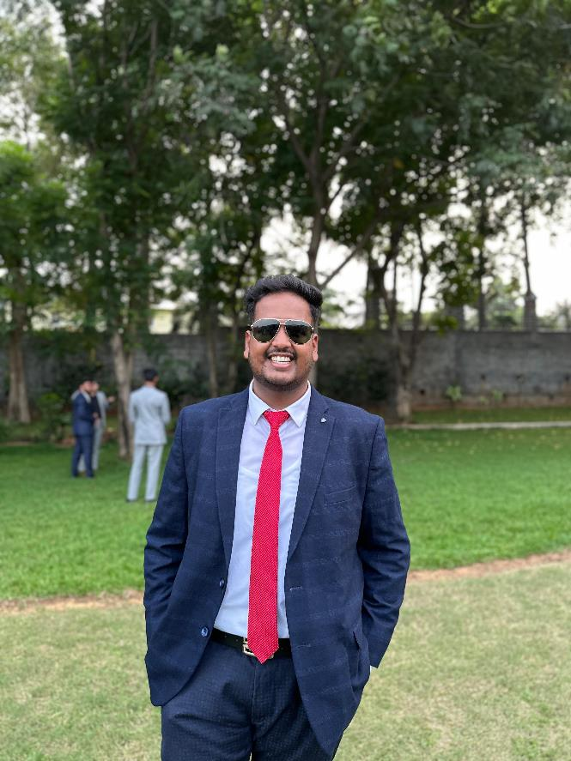
Shell Bootcamp 2024 5 Reflections for Week 2
Shobhit Agrawal
Date : 06-Sept-2024

Slide 2

About Me
Embrace Growth, Achieve Excellence

Slide 3

My learnings from this week!

Slide 4
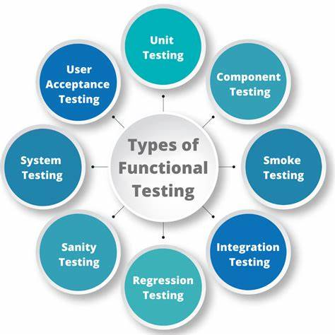
Learning 1 | My takeaways
Functional Testing
Functional testing is a type of software testing that validates the software system against the functional requirements or specifications. It ensures that each function of the software application operates in conformance with the requirement.
Functional testing ensures that energy systems operate correctly under various conditions. This involves rigorous testing of new technologies before deployment to ensure reliability, safety, and efficiency.

Slide 5
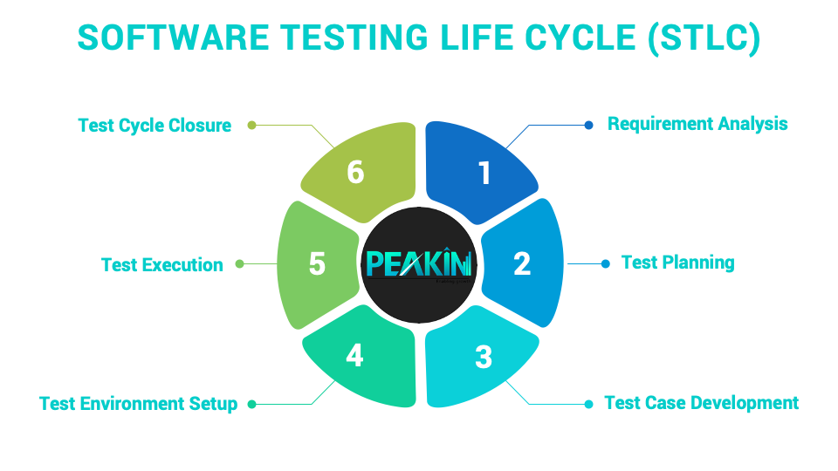
Learning 2 | My takeaways
Software Testing Life Cycle (STLC)
The Software Testing Life Cycle (STLC) is a systematic process that involves several phases to ensure software quality. These phases include Requirement Analysis, Test Planning, Test Case Development, Test Environment Setup, Test Execution, Test Cycle Closure
Implementing STLC in the Energy sector ensures thorough testing of energy management systems, enhancing reliability and efficiency.

Slide 6

Learning 3 | My takeaways
FitNesse Software
FitNesse is a web server, wiki, and automated testing tool designed to support acceptance testing by providing detailed, readable descriptions of system functions. It facilitates collaboration between developers and testers to ensure software meets user expectations
It can be used to automate acceptance testing of energy management systems, ensuring they meet user requirements. This enhances collaboration between developers and testers, leading to more reliable energy solutions.

Slide 7
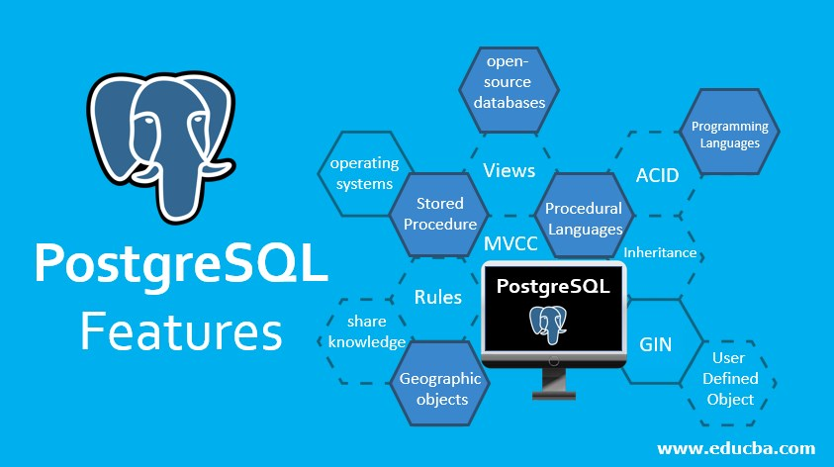
Learning 4 | My takeaways
PostgreSQL
PostgreSQL is a powerful, open-source object-relational database system known for its reliability, feature robustness, and performance. It supports both SQL and JSON querying, making it highly versatile for various applications
PostgreSQL can be used in the Energy sector to manage and analyze large datasets from energy consumption and production. This helps optimize energy distribution and improve decision-making processes.

Slide 8
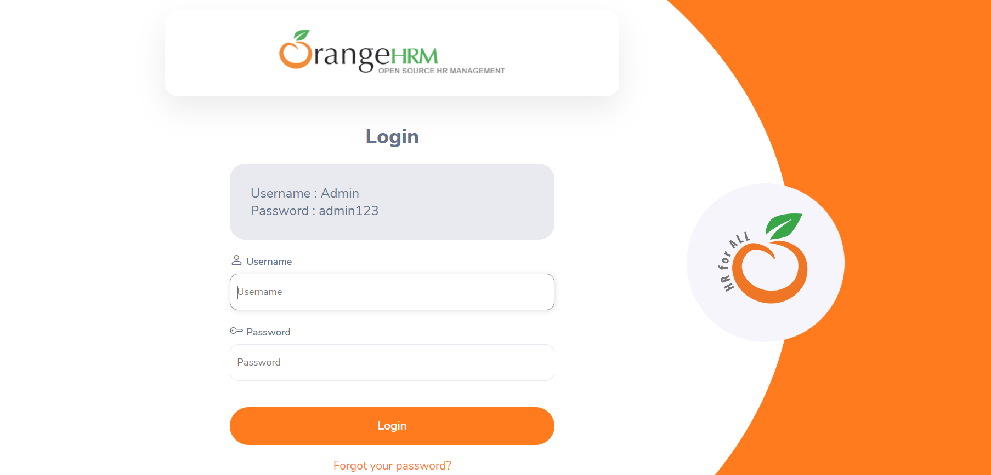
Learning 5 | My takeaways
Final Case Study of OrangeHRM
We had to do 2 tasks in total, one was to create a GitHub CI/CD pipeline to automate the integration and deployment of the code. Other was to test the OrangeHRM website and write the test cases along with the bug report.
This was a very interesting case study as it allowed us to identify where we can apply the concepts in the energy industry. It was a great learning experience.

Slide 9

Relevance of learnings for my organization

Slide 10
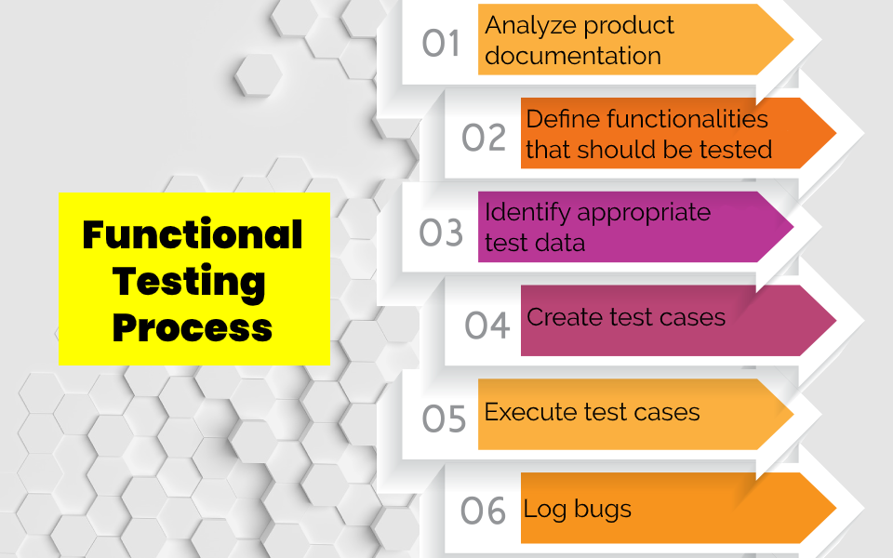
Learning 1 | Relevance for Shell
Shell uses functional testing to ensure their energy systems and technologies operate correctly under various conditions, minimizing risks and enhancing reliability.
This approach helps Shell identify and fix issues early, leading to more efficient and safe energy solutions, ultimately improving customer satisfaction and operational efficiency.

Slide 11
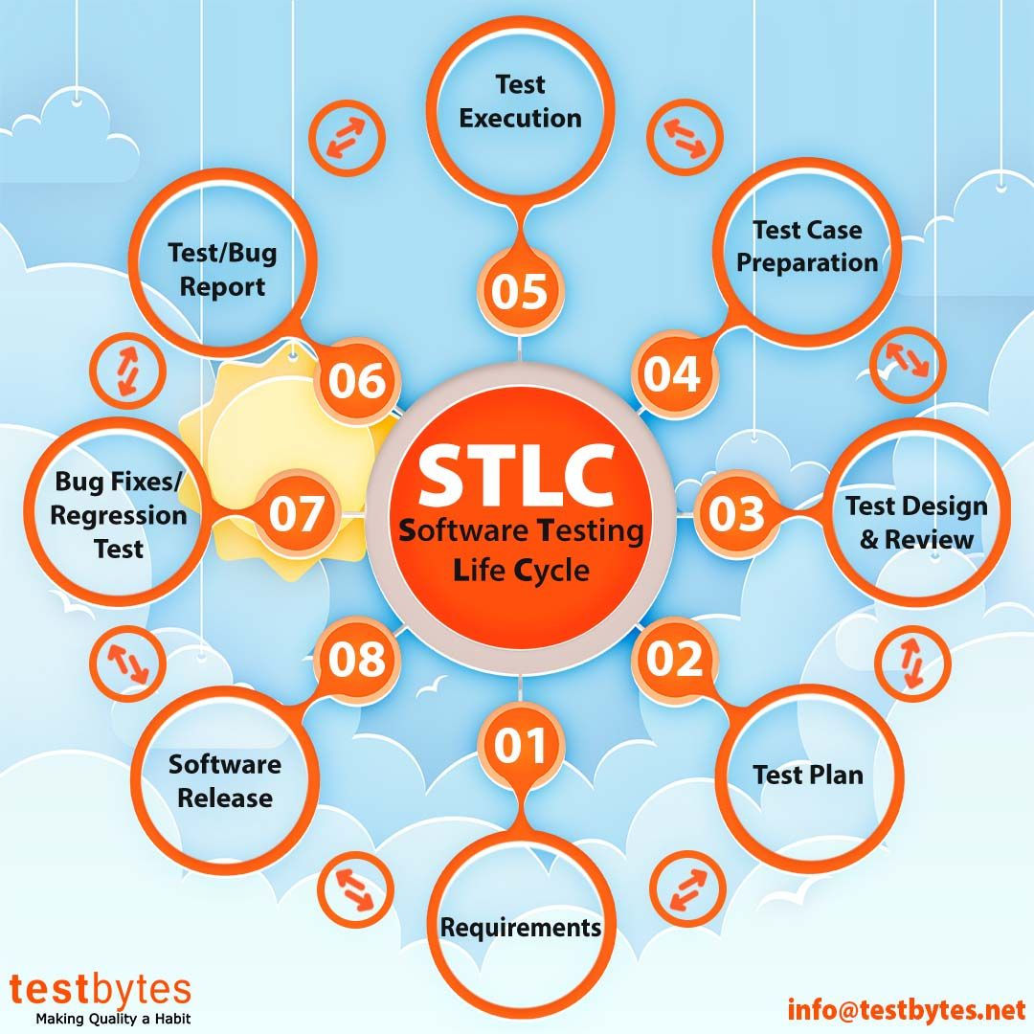
Learning 2 | Relevance for Shell
Shell implements STLC by systematically testing their energy management systems at each phase, from requirement analysis to test cycle closure, ensuring comprehensive quality checks.
This structured approach helps Shell identify and resolve issues early, leading to more reliable, efficient, and safe energy solutions, ultimately enhancing operational performance and customer trust.

Slide 12
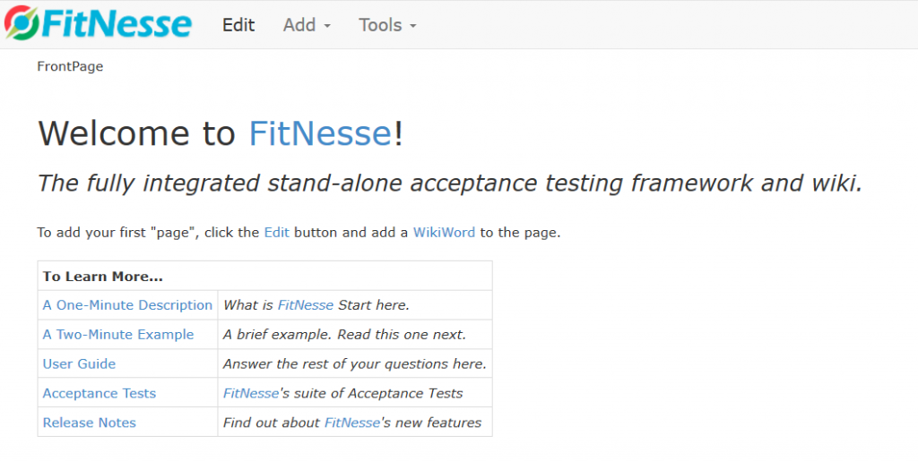
Learning 3 | Relevance for Shell
Shell uses FitNesse to automate acceptance testing of their energy management systems, ensuring they meet user requirements and function as expected.
This enhances collaboration between developers and testers, leading to more reliable and efficient energy solutions, ultimately improving operational performance and customer satisfaction.

Slide 13
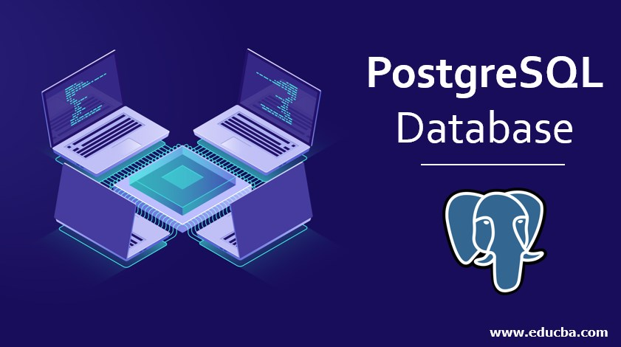
Learning 4 | Relevance for Shell
Shell uses PostgreSQL to manage and analyze large datasets from energy consumption and production, optimizing data storage and retrieval processes.
This enables Shell to make data-driven decisions, improving energy distribution efficiency and enhancing overall operational performance.

Slide 14
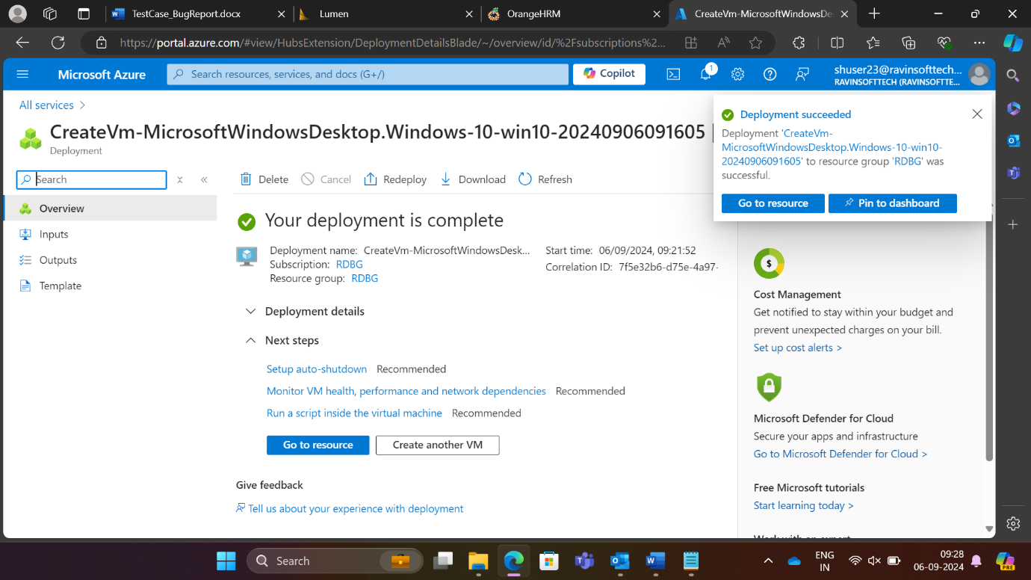
Learning 5 | Relevance for Shell
I think that the tasks that we did today will play a very important role in the projects that we will be assigned in Shell in the future. The knowledge I gained today by doing practical hands on will surely help me in achieving the organization’s goal.
I think due to this case study, Shell will surely benefit, as all of us are a part of Shell now and we will be working on official projects now. So, if we perform well in implementing these projects, surely, we will be contributing in Shell’s growth.

Slide 15

Challenges in implementing learning

Slide 16
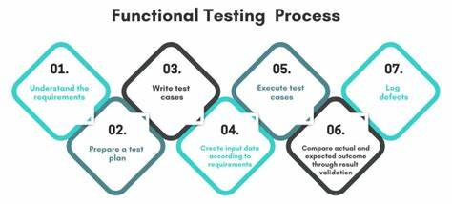
Challenge faced while implementing Learning 1
Challenges:
Lack of clear requirements: Difficulty in determining what needs to be tested.
Complex test environments: Challenges in setting up environments that mimic production.
Time constraints: Insufficient time for thorough testing.
Plan to Overcome:
Clarify requirements: Work with stakeholders to document requirements before testing.
Use virtualization tools: Create scalable and manageable test environments.

Slide 17
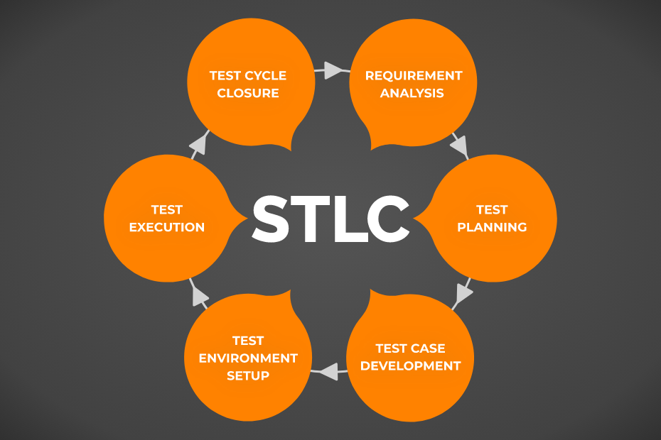
Challenge faced while implementing Learning 2
Challenges:
Requirement Ambiguity: Unclear or changing requirements can disrupt the testing process.
Resource Constraints: Limited resources for comprehensive testing.
Integration Issues: Difficulties in integrating various components and systems.
Plan to Overcome:
Requirement Clarification: Engage stakeholders early to ensure clear and stable requirements.
Resource Allocation: Prioritize critical tests and advocate for necessary resources.

Slide 18
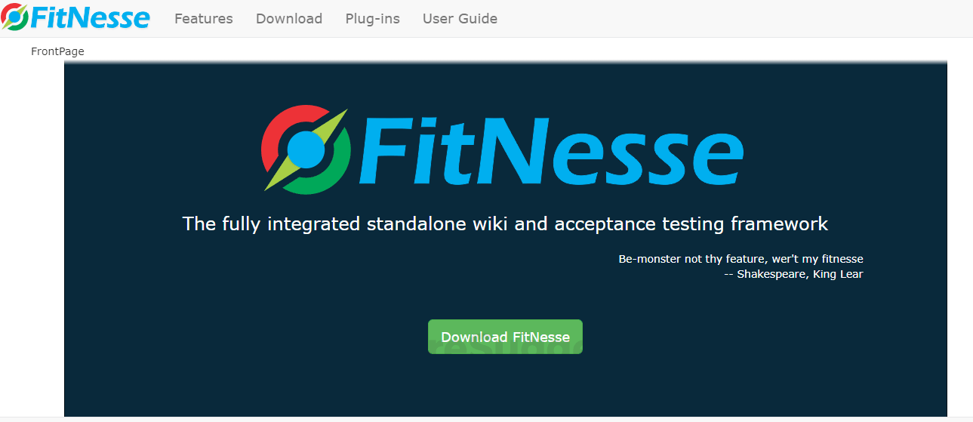
Challenge faced while implementing Learning 3
Challenges:
Learning Curve: Difficulty in understanding and using FitNesse effectively.
Integration Issues: Challenges in integrating FitNesse with existing systems and workflows.
Maintenance: Keeping test cases up-to-date with frequent changes in requirements.
Plan to Overcome:
Training: Invest in training sessions and resources to improve proficiency with FitNesse.
Incremental Integration: Gradually integrate FitNesse into the workflow, starting with smaller projects.

Slide 19
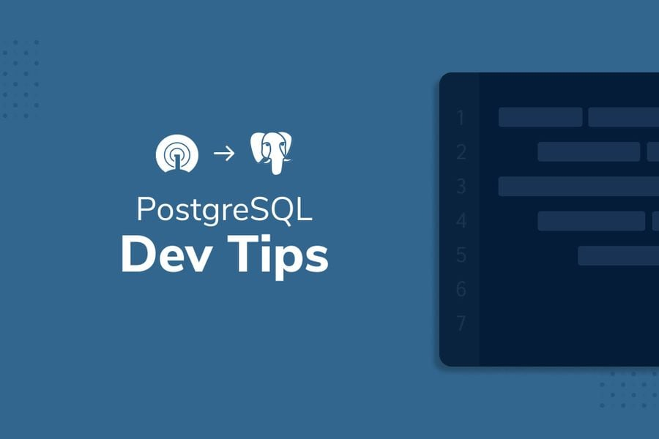
Challenge faced while implementing Learning 4
Challenges:
Data Migration: Difficulty in migrating data from legacy systems to PostgreSQL.
Performance Tuning: Ensuring optimal performance for large datasets.
Security Management: Implementing robust security measures to protect sensitive data.
Plan to Overcome:
Data Migration Tools: Use specialized tools and scripts to facilitate smooth data migration.
Performance Optimization: Regularly monitor and tune database performance using PostgreSQL’s built-in tools.

Slide 20
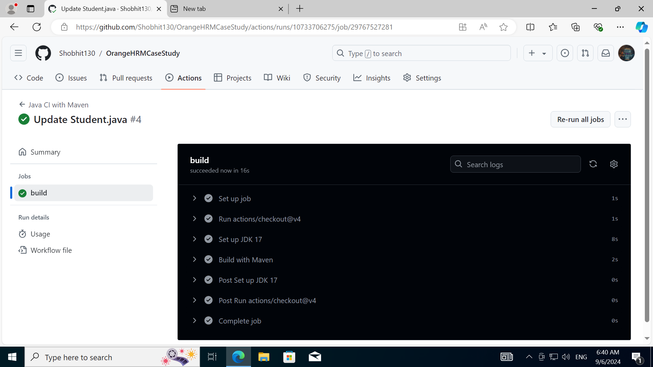
Challenge faced while implementing Learning 5
Challenges:
Time constraint: It was main challenge that I faced as we were given 2 tasks in total
Finding the bugs: The demo site was huge, and it was difficult to find the bugs
Preparing the documentation for test cases and bug reports: It was also one of the main challenges
Plan to Overcome:
Practice: Continuous practice is the only thing which will help in finding the bugs and doing the documentation
Teamwork: Working in teams is far better than working alone as it help in getting different opinions of different teammates

Slide 21

Action Plan

Slide 22
My Action Plan for this Week
Actions
Timeline
Status
Practicing and learning all my learnings including:
Functional Testing PostgreSQL Revising the Case study, where I lacked Different phases of STLC
I am thinking of following the below timeline:
Saturday – Brush up on all my key learnings including all the technical concepts Sunday – Do hands on all the software that we learnt
I think that the status will be complete by the end of the week for all my learnings

Slide 23

Learning is also Fun!

Slide 24
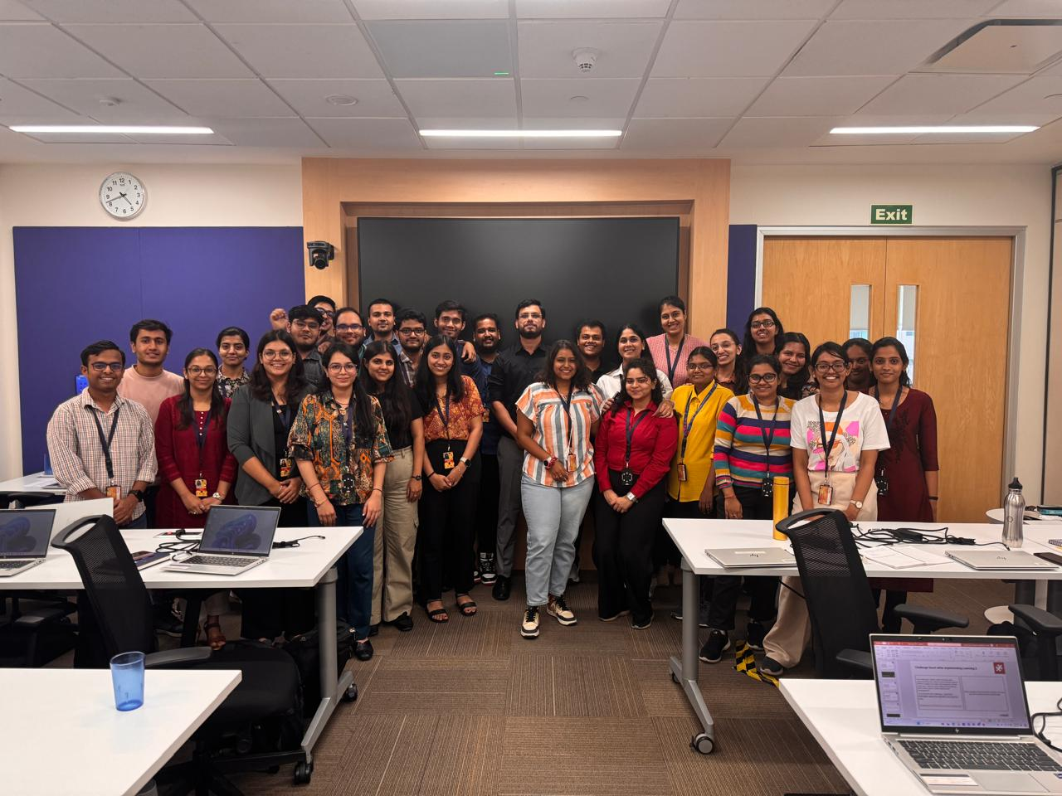
Learning is also Fun!
Mohammad Sohel Abbasi sir is a perfect example of how interactive learning is done. He is very good in teaching concepts; he gives us real life examples for each concept and motivates us for doing well in our life and make our parents proud. Also, he made us realize that documentation is also the important part rather than only doing coding. He never hesitates in taking doubts and always encourage us to do better in life.

Slide 25

Summary
Learned very effectively all my key learnings including Functional testing, different types of testing, STLC, PostgreSQL and also the case study was a great learning. I think that I will remember these concepts and apply them in my professional life.
I think these topics are very important for the role I am going to play in the organization as a Software Engineer. These concepts will help me in developing my knowledge in the field of software engineering and implement these in my professional career.
Overall, the last day’s case study was a very good way in which we were able to test our knowledge on these topics and how we can apply them in the projects that we will be working on in the future of Shell.

Slide 26
Thank You

